Slide 1
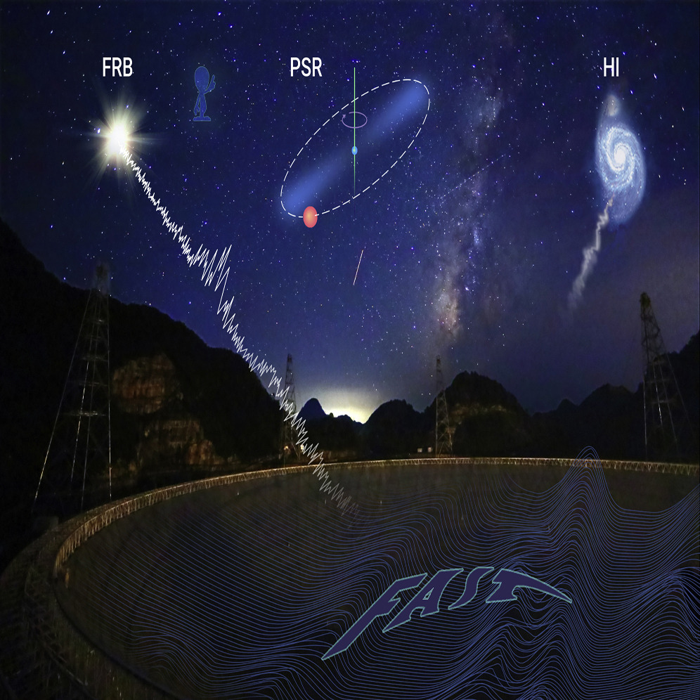
Search for Optical Counterparts
to Isolated FASHI Sources
Marko Grozdanović, PhD candidate
Astronomical Observatory, Belgrade

Slide 2
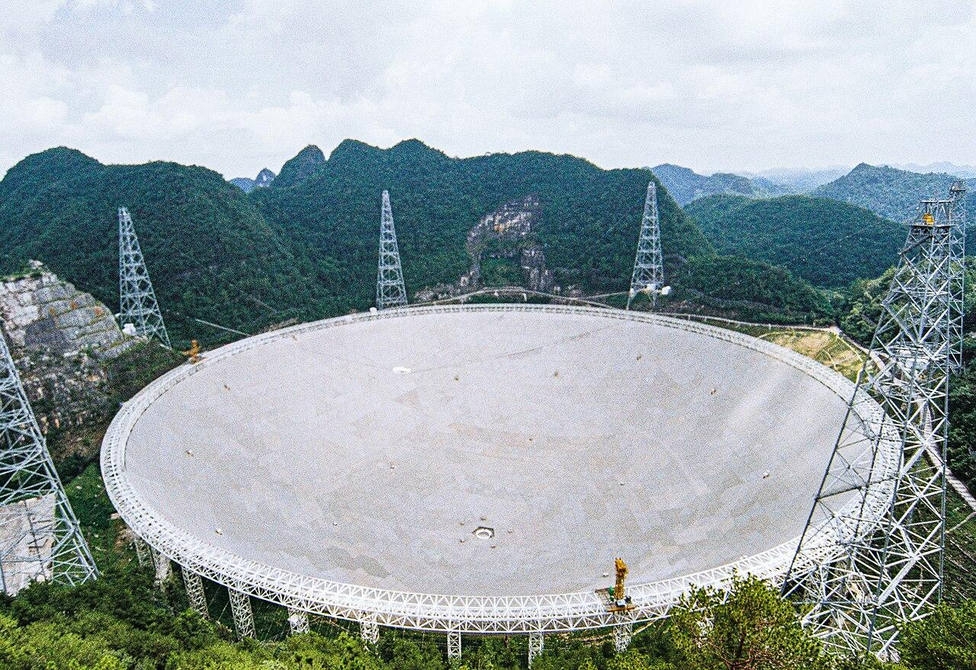
The FAST Telescope & FASHI Survey:
Sensitivity and Discoveries
FAST Telescope (Five hundred meter Aperture Spherical Telescope): 500-meter aperture, 19-beam array (~25 K), and 1.6 km s⁻¹ velocity resolution designed for weak HI sources.
FASHI Survey (FAST All Sky HI Survey): The most sensitive blind HI survey to date, mapping local gas-rich structures.
Xu et al. (2023) detected FAST J0139+4328, claiming the discovery of the first isolated dark dwarf galaxy in the nearby universe.
Search for Optical Counterparts to Isolated FASHI Sources

Slide 3
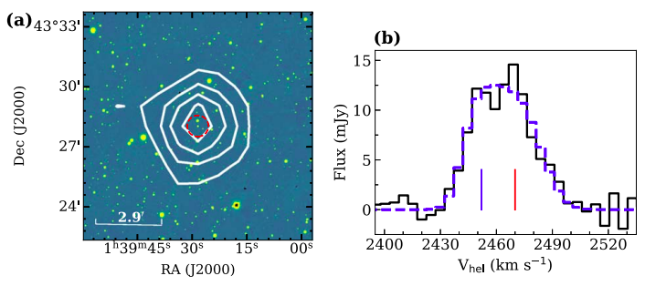
Key Scientific Findings:
Gas-Rich Rotating Disk: Rotating gas kinematics are clearly demonstrated by a double-peak HI profile.
Dark Matter Dominance: The dynamical-to-baryonic mass ratio is 47 ± 27, proving dark matter heavily dominates the system.
Earliest Evolutionary Stage: Possesses an extremely low stellar mass (< 6.9 × 10⁵ M_sun) despite rotating, representing the primordial phase of galaxy formation.
First Isolated Dark Galaxy: Observational evidence confirms FAST J0139+4328 is the first isolated dark dwarf galaxy detected in the nearby universe.
FAST J0139+4328:
Morphology & Key Properties
Figure 1: Morphology of FAST J0139+4328
(a) HI column-density map (white contours) overlaid on the Pan-STARRS1 g-band image. Contours begin at 3σ in steps of 1.9 × 10¹⁸ cm⁻²; the red dashed circle represents 3 × expected D₂₅.
(b) Global HI profile with BusyFit fitting (blue dashed line), indicating a rotating disk galaxy structure.
Search for Optical Counterparts to Isolated FASHI Sources

Slide 4
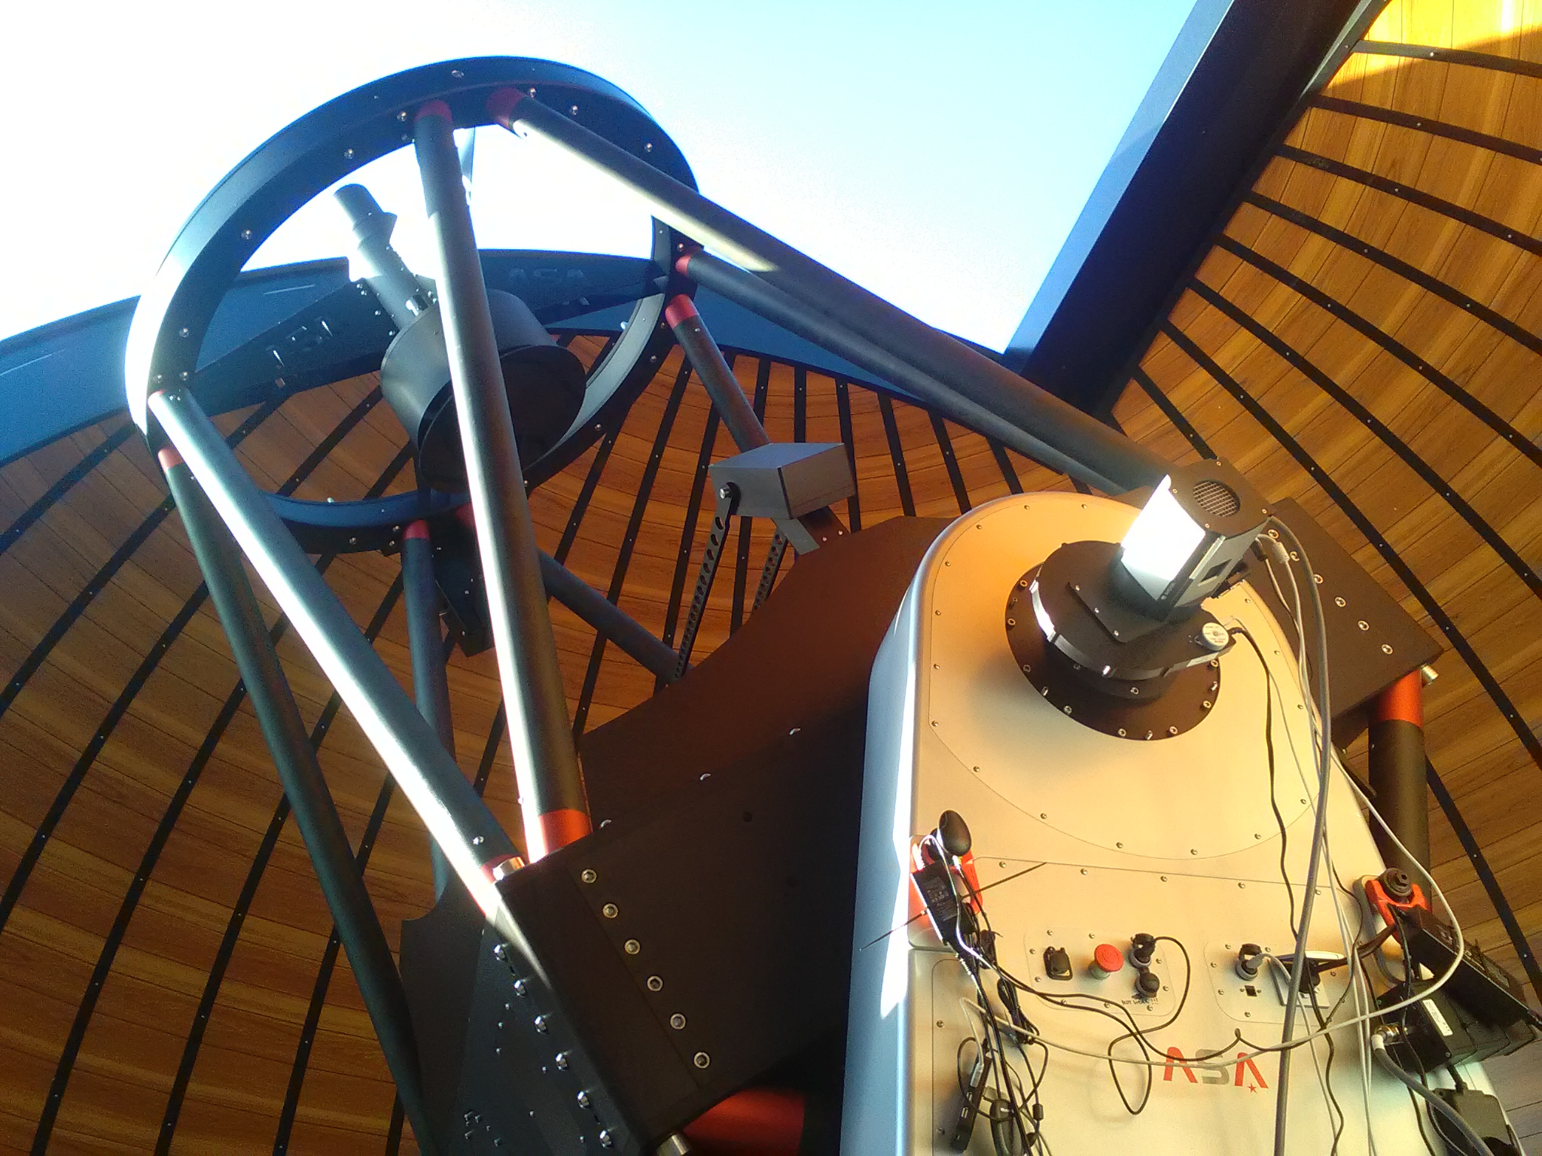
Deep Optical Follow-Up
To definitively rule out or confirm a faint stellar counterpart for FAST J0139+4328, requires optical imaging significantly deeper than Pan-STARRS1.
Observations were conducted at the Astronomical Station Vidojevica (Serbia):
1.4 m Milanković telescope (L, B, and V bands)
0.6 m Nedeljković telescope (I band)
Observations:
Long integrations (totaling 7h, 6.35h, 4.35h, and 9.66h in L, B, V, and I bands) and specific dithering patterns were used to reach LSB depths and mitigate systematics.
Search for Optical Counterparts to Isolated FASHI Sources

Slide 5
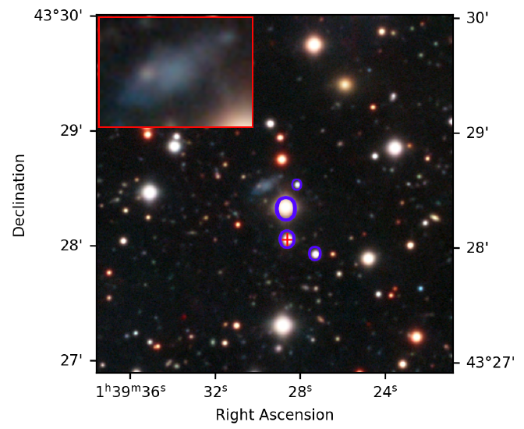
Unveiling the Counterpart of FAST J0139+4328
Discovery: Deep imaging unambiguously revealed a faint stellar counterpart at the location of the HI cloud.
Morphology: A faint, irregular, low-surface-brightness structure (appearing blue in the composite image) was detected.
Alignment: The position of the optical center is offset by ~30.3 arcsec from the reported HI coordinates, which is well within the ~3 arcmin FAST beam.
Mitrašinović, A., Grozdanović, M. Lalović, A., Bilek, M. et al., “Discovery of a galaxy associated with the HI cloud FAST J0139+4328”, Astronomy and Astrophysics, vol. 705, 2026. doi:10.1051/0004-6361/202558391.
Figure 1: Composite optical image showing the optical counterpart
Search for Optical Counterparts to Isolated FASHI Sources

Slide 6
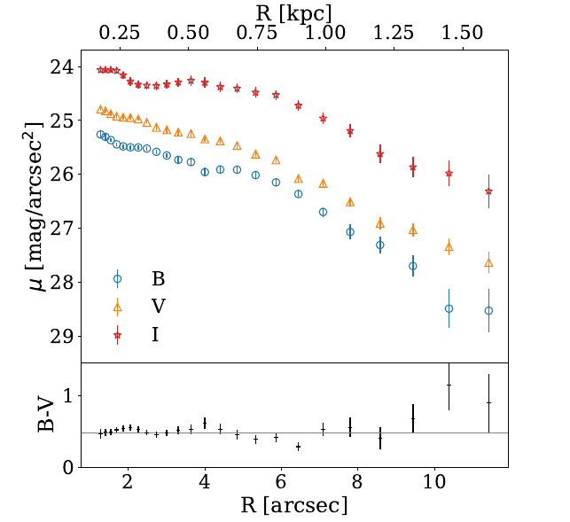
Detailed Physical Properties and Stellar Mass Estimation
Structural Parameters
The galaxy has a half-light radius of 5.24 arcsec, corresponding to ~0.73 kpc at the adopted distance of 28.8 Mpc.
Luminosity & Color
We measured a total absolute B-band luminosity of L_{B} = (1.11 ± 0.23) × 10⁷ L⊙. The mean (B-V) color of ~0.48 indicates a relatively blue stellar population.
Stellar Mass
Using color-mass-to-light relations, we derived a total stellar mass of M* = (7.2 ± 3.7) × 10⁶ M⊙.
Gas Fraction
Combined with the literature HI mass, this yields an extremely high gas-to-stellar mass ratio of MHI/M* = 11.5 ± 6.4.
Search for Optical Counterparts to Isolated FASHI Sources

Slide 7
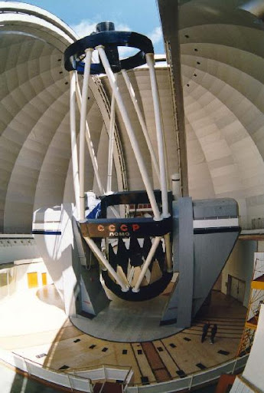
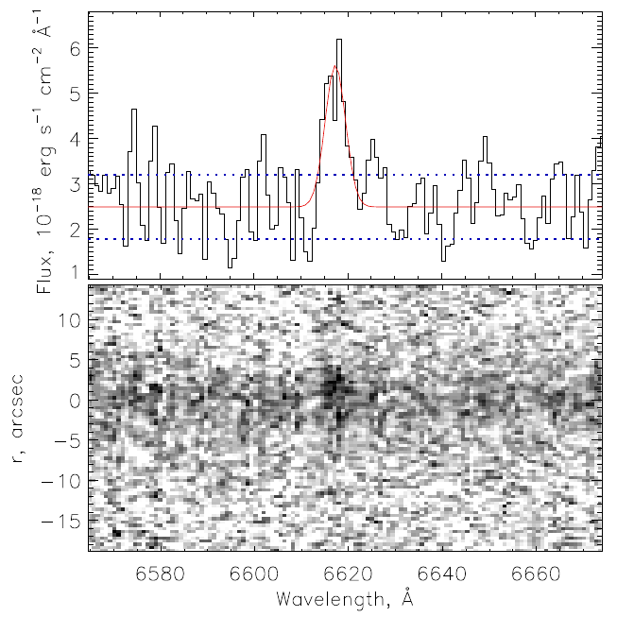
Spectroscopic Validation at the
6m Big Telescope Alt-Azimuthal (BTA)
Kinematic Velocity Agreement
BTA Spectroscopy
2492
± 25 km/s (Vhel)
FAST HI Survey
2464.4
± 0.8 km/s
Figure 1
6m BTA Telescope (SAO RAS)
Long-slit spectroscopy was executed at the Special Astrophysical Observatory (SAO RAS) to validate system coordinates.
The measured velocities agree within the 1σ interval, validating the physical association between the systems.
Hα Emission Line
Resulting spectrum exhibits a faint stellar continuum accompanied by a single redshifted Hα emission line.
Search for Optical Counterparts to Isolated FASHI Sources

Slide 8
Reclassification: Resolving the First
Isolated Dark Galaxy Candidate
Conclusion
FAST J0139+4328 is not a dark galaxy. It is an extremely gas-rich, low-surface-brightness (LSB) dwarf galaxy.
Its stellar component was simply below the detection limit of the Pan-STARRS1 survey (~24 mag/arcsec²).
This finding demonstrates that non-detections in medium-depth surveys cannot rule out stellar populations in faint HI systems, emphasizing the need for deep optical follow-up.
Search for Optical Counterparts to Isolated FASHI Sources

Slide 9
Program Announcement
Introducing the GHOST Program (Grozdanović et al. 2026)
Gas-rich HI-selected Optically faint Systems
Initiative: Following the reclassification of FAST J0139+4328, we initiated a systematic search of FASHI sources to identify faint, previously uncataloged stellar counterparts in deep optical imaging.
Program Goals
Identify Uncataloged Counterparts
Cross-match the FASHI catalog with the DESI Legacy Imaging Surveys to detect visible but previously unidentified optical counterparts.
Derive Physical Properties
Model structural parameters, stellar masses, and gas fractions to thoroughly characterize the newly identified galaxy population.
Kinematic & BTFR Analysis
Analyze velocity profiles and place the rotationally supported systems on the Baryonic Tully-Fisher Relation to evaluate scaling laws.
Search for Optical Counterparts to Isolated FASHI Sources

Slide 10

DESI Legacy Imaging Surveys
Achieved Depths in DESI Legacy Surveys
Comparison of limiting surface brightness (3σ, 10″×10″) by filter and observational setup
Filter | DECaLS (3σ, 10″×10″) | BASS / MzLS (3σ, 10″×10″) | Difference (Δμ)
g-band | 28.32 – 29.3 mag arcsec⁻² | 27.65 – 28.1 mag arcsec⁻² | BASS shallower by ~0.67 mag
r-band | 27.99 – 28.8 mag arcsec⁻² | 27.31 – 27.8 mag arcsec⁻² | BASS shallower by ~0.68 mag
z-band | 27.9 ± 0.3 mag arcsec⁻² | ~27.5 – 27.8 mag arcsec⁻² (MzLS 4-m Mayall) | Similar (both 4-m telescopes)
* The range of values for DECaLS originates from the difference between conservative studies with strict masking (e.g. Li et al.) and recent measurements on large co-added samples (Gordon et al. 2024).
DECaLS: Dark Energy Camera Legacy Survey (4-m Blanco Telescope, CTIO, Chile – Southern sky) • BASS: Beijing-Arizona Sky Survey (2.3-m Bok Telescope, Kitt Peak, USA – Northern sky) • MzLS: Mayall z-band Legacy Survey (4-m Mayall Telescope, Kitt Peak, USA – Northern sky)
Search for Optical Counterparts to Isolated FASHI Sources

Slide 11
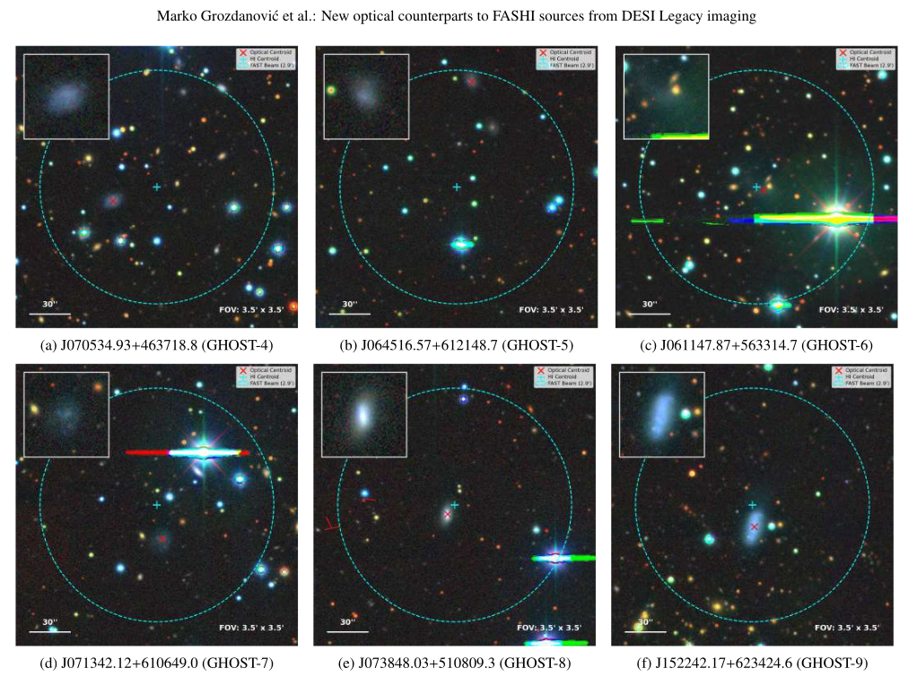
Identifications of new galaxies
Over 30 LSB Dwarf Galaxies Identified
Cross-matching nearby FASHI sources with deep DESI Legacy Imaging revealed 33 highly probable optical counterparts, including 27 newly discovered, previously uncataloged LSB dwarf stellar systems.
Structural & Photometric Modeling
Derived Sérsic profiles, effective radii, and surface brightness in DESI imaging. Estimated stellar masses using photomass, revealing highly gas-dominated systems.
HI Kinematics & BTFR Testing
Classified HI velocity profiles (single vs. double-peaked) and confirmed that rotationally supported double-peaked systems align with the Baryonic Tully-Fisher Relation.
Search for Optical Counterparts to Isolated FASHI Sources

Slide 12
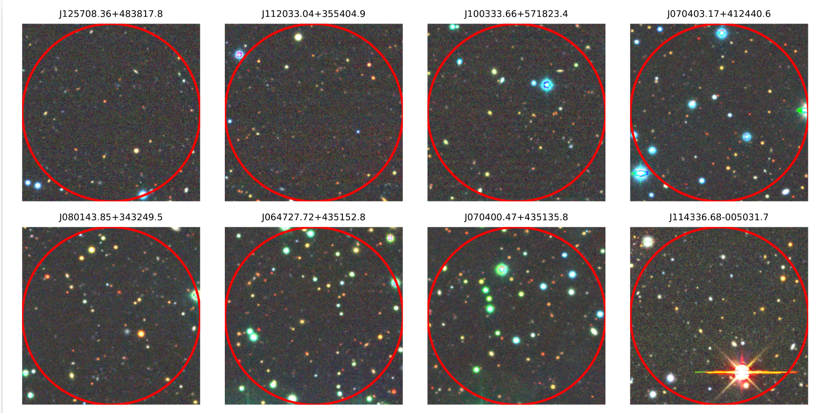
Truly Optically "Dark" Candidates
Many fields show absolutely no visible optical emission even at deep DESI limits. These remain exceptional dark galaxy candidates that require targeted optical follow-up.
Deeper observations needed for detection!!

Slide 13
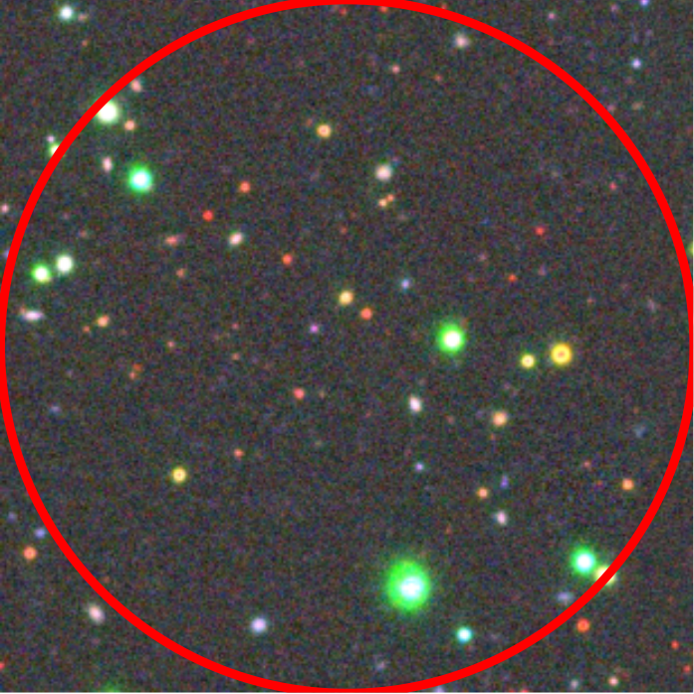
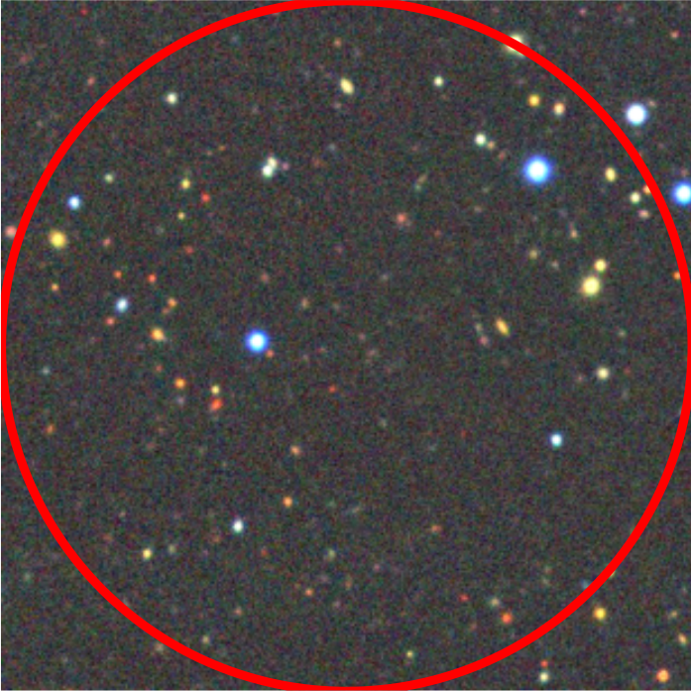
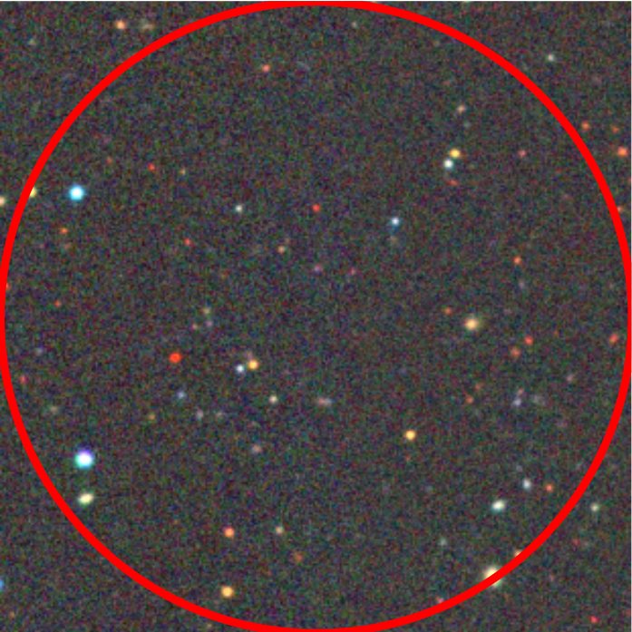
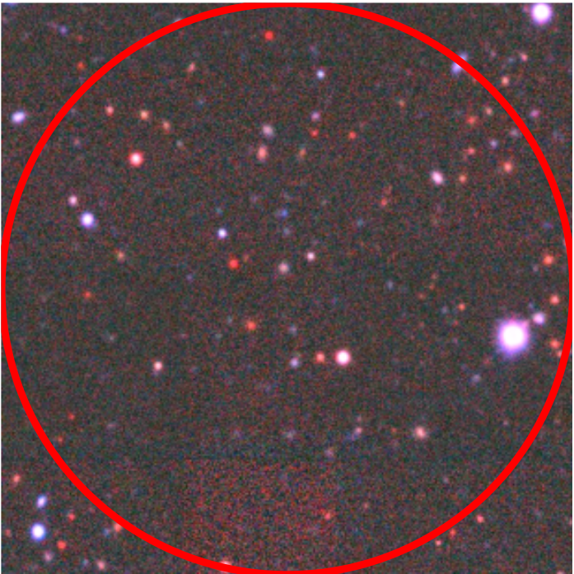
Surface Brightness Comparison: Milanković vs. DESI Legacy Survey
Photometric surface brightness limits at 10.0" scale boxes for DARK-1 to DARK-4
DARK-1 (243.7111°, 42.8907°)
Milanković (13.7h, L-band)
3.0σ limit: 28.16 mag/arcsec²
1.0σ limit: 29.35 mag/arcsec²
DESI Legacy Survey (LSS)
r-band 3.0σ: 27.40 | 1.0σ: 28.59
g-band 3.0σ: 27.82 | 1.0σ: 29.02
DARK-2 (248.0596°, 52.4922°)
Milanković (15.5h, L-band)
3.0σ limit: 28.31 mag/arcsec²
1.0σ limit: 29.51 mag/arcsec²
DESI Legacy Survey (LSS)
r-band 3.0σ: 27.57 | 1.0σ: 28.77
g-band 3.0σ: 27.99 | 1.0σ: 29.19
DARK-3 (241.7687°, 49.5457°)
Milanković (22.5h, L-band)
3.0σ limit: 28.68 mag/arcsec²
1.0σ limit: 29.88 mag/arcsec²
DESI Legacy Survey (LSS)
r-band 3.0σ: 27.31 | 1.0σ: 28.50
g-band 3.0σ: 27.96 | 1.0σ: 29.15
DARK-4 (3.7911°, 32.4327°)
Milanković (14.58h, L-band)
3.0σ limit: 28.40 mag/arcsec²
1.0σ limit: 29.60 mag/arcsec²
DESI Legacy Survey (LSS)
r-band 3.0σ: 27.42 | 1.0σ: 28.61
g-band 3.0σ: 28.02 | 1.0σ: 29.21
Search for Optical Counterparts to Isolated FASHI Sources

Slide 14
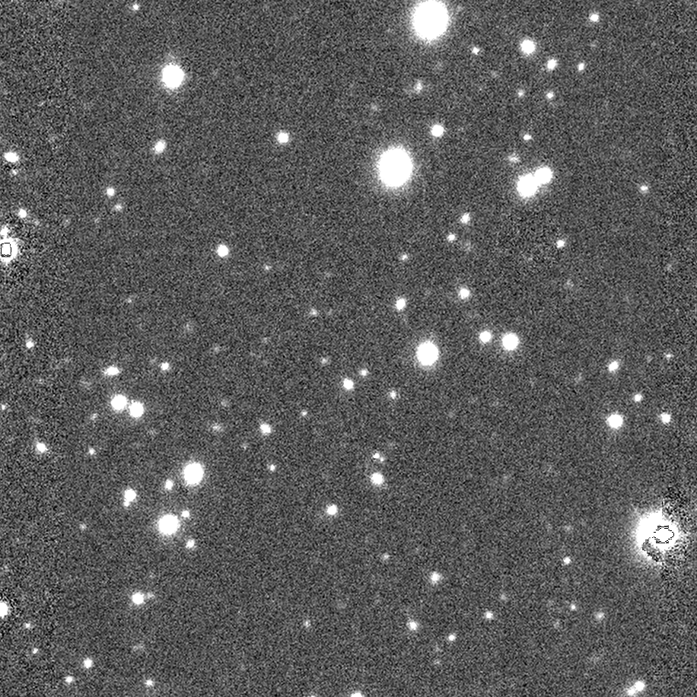
DARK-1

Slide 15
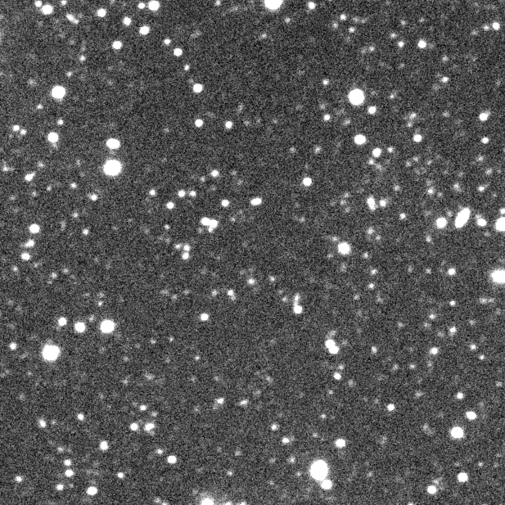
DARK-2

Slide 16
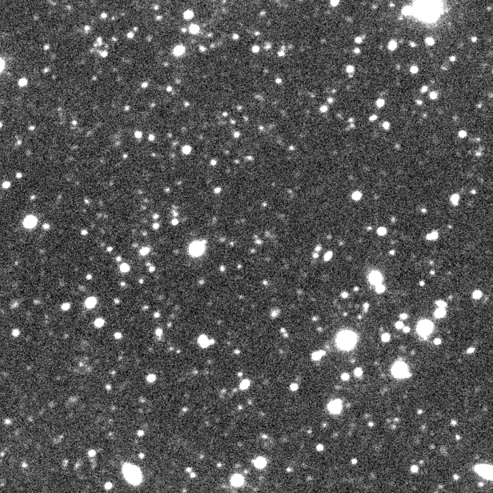
DARK-3

Slide 17
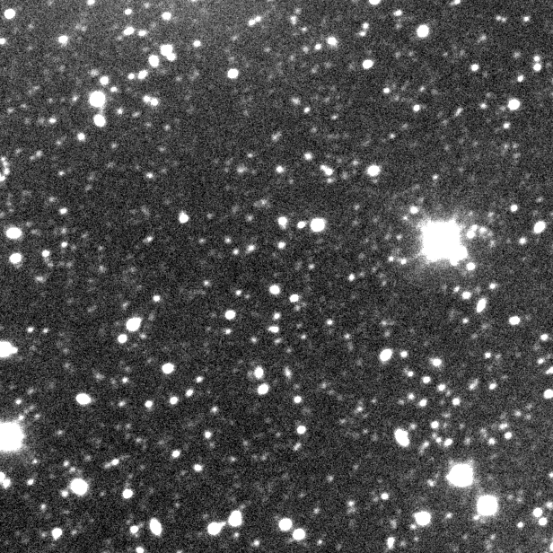
DARK-4

Slide 18
Thank You!
Email: mgrozdanovic@aob.rs

